Slide 1
MSc Practicum: Team Software Project Black Team Final Presentation
18th August 2015
suggested timing 7min for demo, 3 for other 6 sections. each section must finish within these timings
(LOS no - we need to work out correct timing for each section)

Slide 2
The Setting & The Characters
Why does your system exist?
What is the problem that you are trying to solve?
What are the core technical challenges in solving this problem?
Who cares?
Who are your target users?
Why do these users care about this problem?

Slide 3
The Setting & The Characters
Why does your system exist?
Who cares?

Slide 4
DEMO

Slide 5
The System
What does your system do?
What is your system built from?
System architecture diagram
How does your system work?
Describe the key technical aspects of your solution (not every little piece)

Slide 6
The Design
Why is your system designed the way that it is?
Describe the key decisions made to achieve the targeted user experience
How did the design of the system change over the course of the project?

Slide 7
The Business
Customer Value Proposition
Who is the customer?
Advertisers
What does the customer value?
Each of our customers wants to promote their product through the most efficient means possible with the goal of maximising profits.
How does your product/service meet the customer’s needs?
We are creating a hub for users with a keen interest in technology and therefore these users will be more likely to respond to in a favourable way to technology focused advertising.

Slide 8
The Business
Profit Model
How is revenue generated?
The types of advertising we will cater for initially will be
Cost per Click
Cost per Impression
Later on we will explore options in Private Advertising and Affiliates
What is the cost structure?
Our business model strives to keep costs as stable and flexible as possible so that they will start off small and only increase as our business and revenue grows.
Staff costs are split between salary and bonus related to business goals. server is rented per hour rathar than long term lease

Slide 9
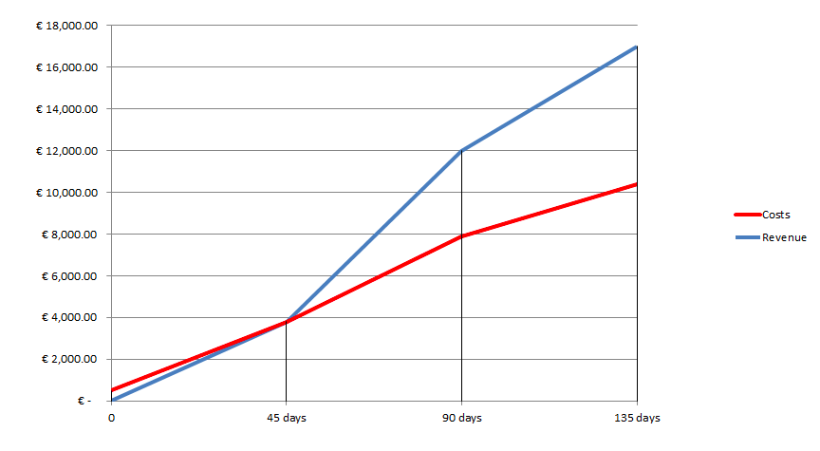
The Business
Profit Model - How exactly is profit created?

Slide 10
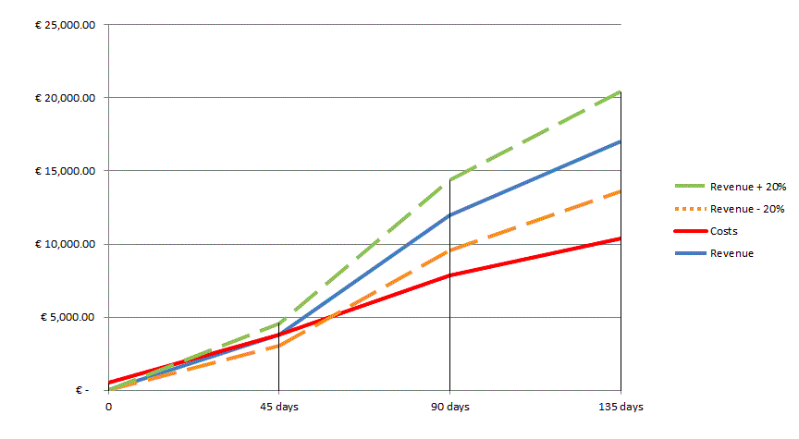
The Business
Profit Model - How exactly is profit created?

Slide 11
The Business
Costs (Staff, Hardware, Events, Marketing)
Revenue (CPC, CPM, Private advertising, Affiliates)
Time Period | Total cost
First 45 days | €3,787
46 to 90 days | €7,870
91 to 135 days | €10,369
Time Period | Total Revenue
First 45 days | €3,807
46 to 90 days | €11,980
91 to 135 days | €16,997

Slide 12
The Business
Critical Processes
What are the business activities critical to you being able to both provide customers with the products and services they value and do so in a profitable manner?
Build User Base
Strong Social Media Presence
Targeted Advertising
Establish and maintain relationship with key partners
Be revenue focused

Slide 13
The Business
Critical Resources
What are the business and technology resources necessary in order to carry out critical processes in an effective and efficient manner?
Hardware
Business and technical skills
Marketing Partner
Resource dedicated to finance

Slide 14
The Reviews
How have you evaluated your system?
Surveymonkey, walkthrough by team, informal reviews by friends/colleagues.
Group discusses on key processes.
include 1 pos & 1 neg quote from feedback

Slide 15
The Reviews
Does your system solve the problem you set out to address?
Yes. Personalisation of articles is working well as evidenced by survey results
include 3 different positive quotes from survey

Slide 16
The Reviews
What are the outstanding problems? TBD after 11/8

Slide 17
The Reviews
What would you do next to improve the system? TBD after 11/8
Tweets related to news topics

Slide 18
Reflections
How successful is your solution?
What parts are most successful? Personalisation(USP)
What parts are least successful? TBD after 11/8

Slide 19
Reflections
What were the biggest challenges you faced as a team in working on this project?
Working and communicating with people in different locations

Slide 20
Reflections
What lessons have you learned by completing this project?
People have different ways of working.

